Slide 1

Presentation On
Weather Forecasting System
Swami Keshanvanand Institute of Technology,
Management and Gramothan, Jaipur
Submitted by:
Niharika Goyal(19ESKIT062) Nayan Gupta (19ESKIT061) Saurabh Nahata (19ESKIT085)
Naresh Kumar(19ESKIT060)
Submitted to:
Mrs. Sanju Chaudhary Associate Professor, IT

Slide 2
Outline
Introduction
Purpose of Project
Abstract
Scope
Requirements Specification
Technologies Used
Output Screens
Benefits
References

Slide 3
Introduction
Welcome to our weather forecast service, where we provide up-to-date and accurate weather information using API (Application Programming Interface). With the power of technology and data, we strive to deliver comprehensive weather forecasts that enable you to plan your day, stay prepared, and make informed decisions.Using API technology, we seamlessly integrate weather data from reliable sources into our service, ensuring that you receive the most recent and precise information about current weather conditions and predictions for various locations worldwide. Whether you're planning a trip, organizing an event, or simply want to know what to expect in your area, our weather forecast API empowers you with the knowledge to stay ahead of changing weather patterns.

Slide 4
Purpose of Project
The purpose of a weather forecast website using an API (Application Programming Interface) is to provide users with up-to-date and accurate weather information for specific locations. The website retrieves data from a weather API, which is a service that collects and organizes weather data from various sources such as meteorological agencies, weather stations, and satellites.
Here are some key purposes of a weather forecast website using an API:
Weather Information
Location-Specific Forecasts
Planning and Preparedness
Alerts and Warnings.

Slide 5
Abstract:
This project aims to integrate weather forecasting and air quality monitoring by utilizing application programming interfaces (APIs). The primary objective is to develop a comprehensive system that offers accurate weather predictions and real-time air quality data to users. To achieve this, a variety of weather and air quality APIs are employed to gather essential information, including temperature, humidity, wind speed, and pollutant levels. These APIs facilitate seamless data retrieval and processing, ensuring that the results are up-to-date and reliable. The system strives to enhance user awareness and decision-making concerning weather conditions and air quality, empowering individuals to make informed choices for their daily activities.

Slide 6
Scope
The weather forecasting system has an application for farmers where they can ensure higher productivity of crops and lower the risk of weather hazards via the IoT weather.
The weather station proves helpful for monitoring the weather in areas like places with volcanoes or rain forests. This is especially important with drastic changes in the weather conditions we are experiencing.
The weather forecasting system using IoT supporting controllers is fully automated and efficient. It does not require any manual labor or attention.
You can plan and visit the places anytime you like with prior notification of the weather conditions. You can simply get the status of the weather condition and the air quality, etc.

Slide 7
Requirements Specification
Software Interface :
Client on Internet :
Web Browser, Operating System (any)
Client on Intranet :
Web Browser, Operating System (any)
Development End :
HTML, CSS, Javascript

Slide 8
Requirements Specification
Tools/IDE: To implement the project we have chosen Visual studio for its more interactive support.

Slide 9
Technologies Used
HTML, CSS, Javascript:
HTML is an acronym which stands for Hyper Text Markup Language which is used for creating web pages and web applications. Let's see what is meant by Hypertext Markup Language, and Web page.
CSS stands for Cascading Style Sheets. It is a style sheet language which is used to describe the look and formatting of a document written in markup language.
JavaScript is a dynamic computer programming language. It is lightweight and most commonly used as a part of web pages, whose implementations allow client-side script to interact with the user and make dynamic pages

Slide 10
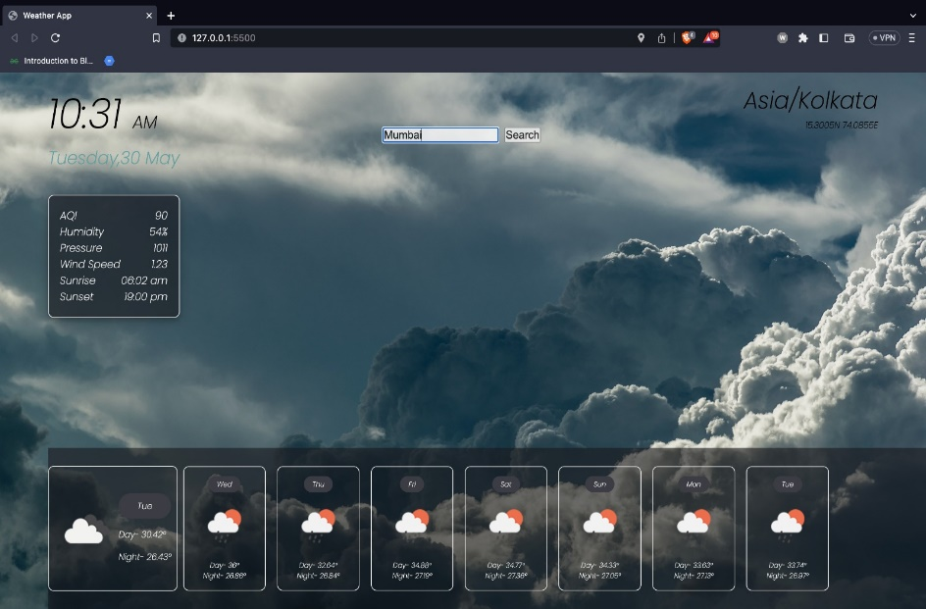
Output Screens Shots

Slide 11
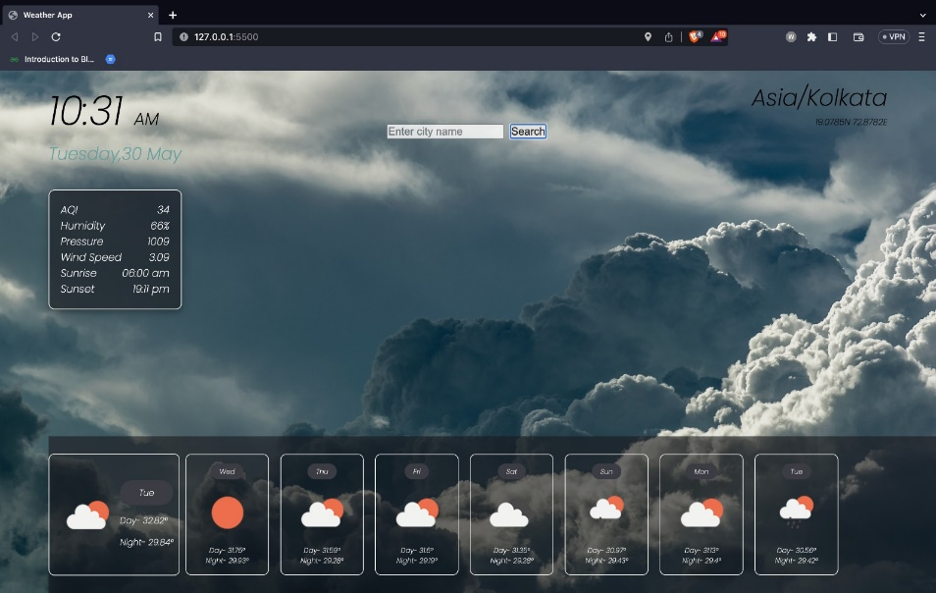

Slide 12
Benefits
Farmers can known when to plant or harvest their crops
People cam choose where and when to take their holidays to take advantages of good weather
Surfers known when large waves are expected
Regions can be evacuated if hurricanes or floods are expected
Aircraft and shipping rely heavily on accurate weather forecasting

Slide 13
References
https://rapidapi.com/blog/create-weather-website/
https://www.codementor.io/projects/web/weather-forecast-website-atx32lz7zb
https://www.freecodecamp.org/news/how-i-built-my-own-forecasting-tool-using-a-weather-api/
https://github.com/topics/weather-website

